Slide 1
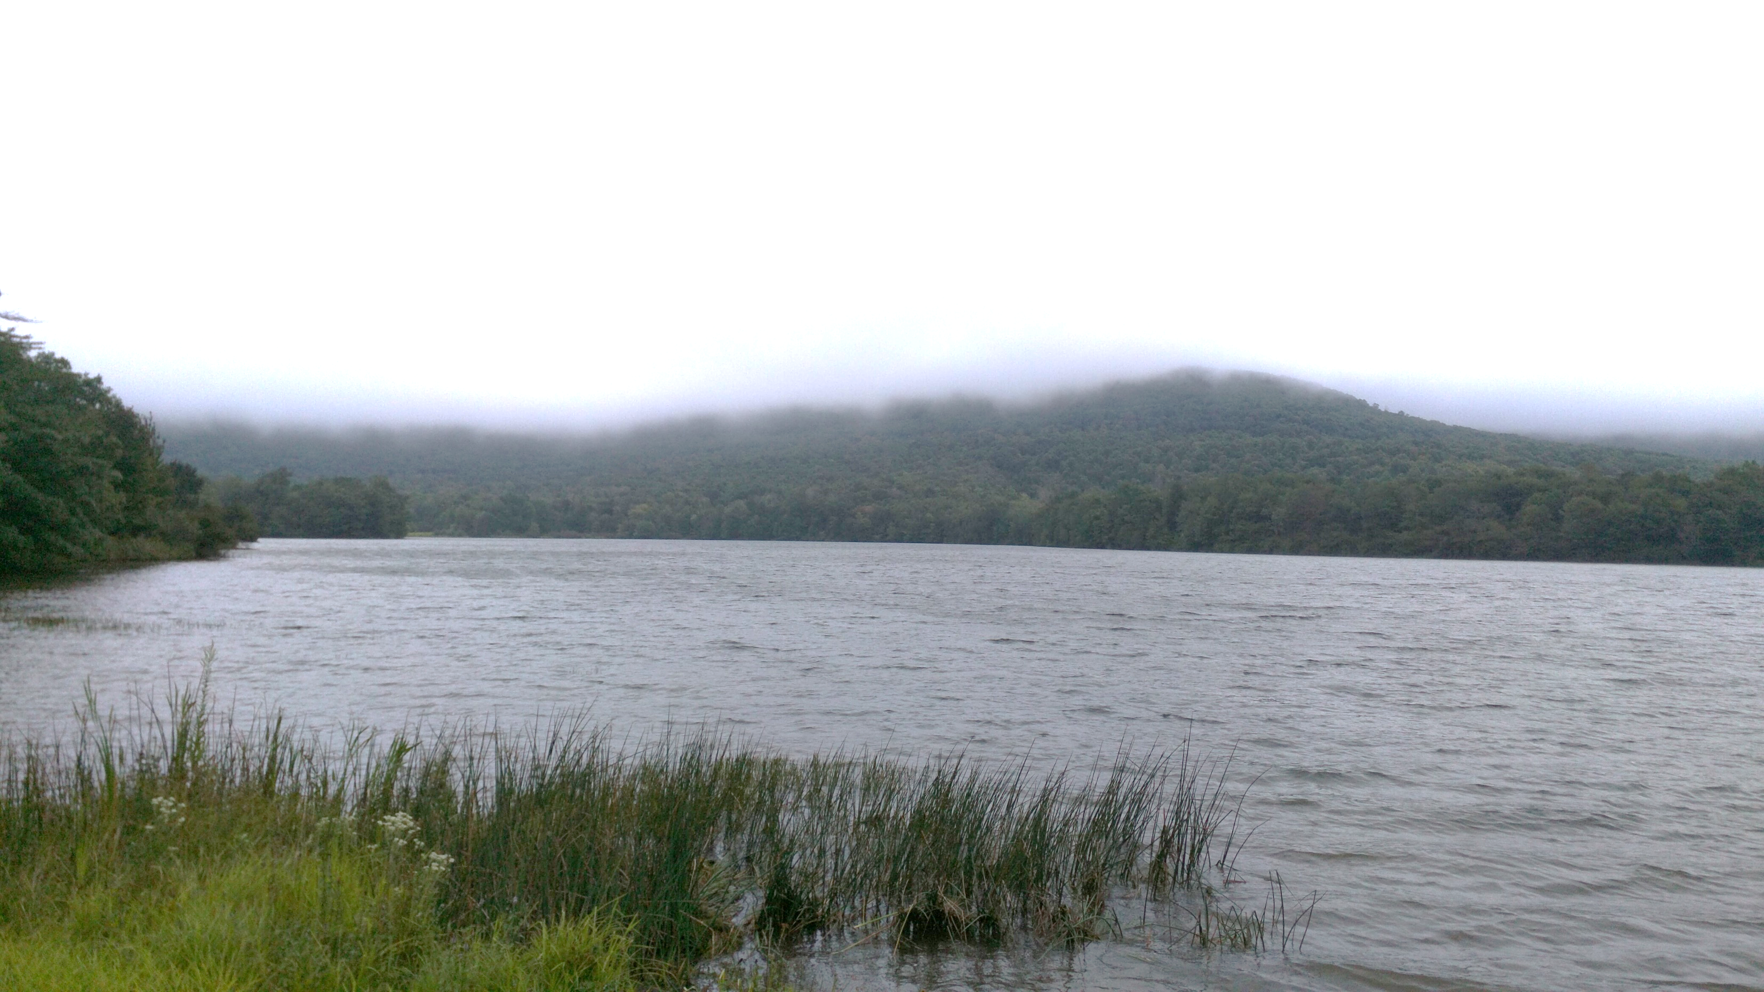
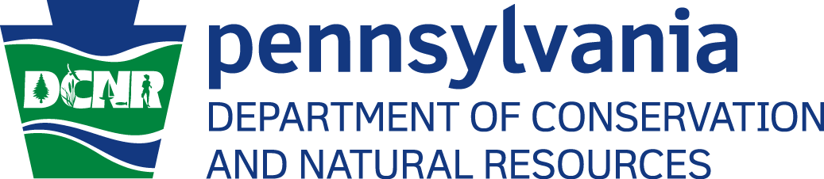
River Life in the Ohio River Basin
DCNR Bureau of Forestry
Rachael Mahony

Slide 2
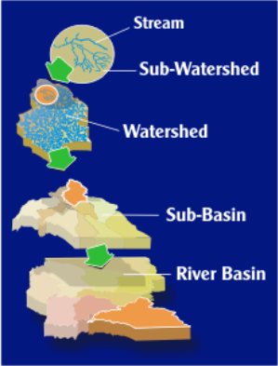
River Basin or Watershed?
River basin
Large land area that is made up of many watersheds.
The BIG picture!
Watershed
Land area from which surface runoff drains into a stream, lake, reservoir, or other body of water.
A smaller snapshot!

Slide 3
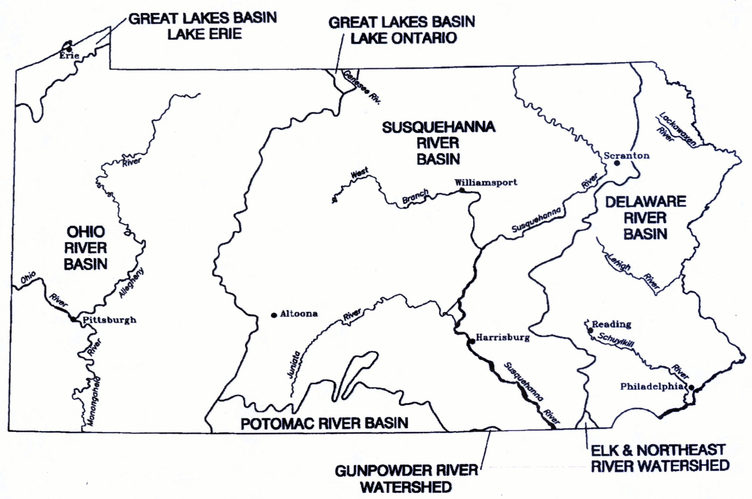
Pennsylvania’s River Basins

Slide 4
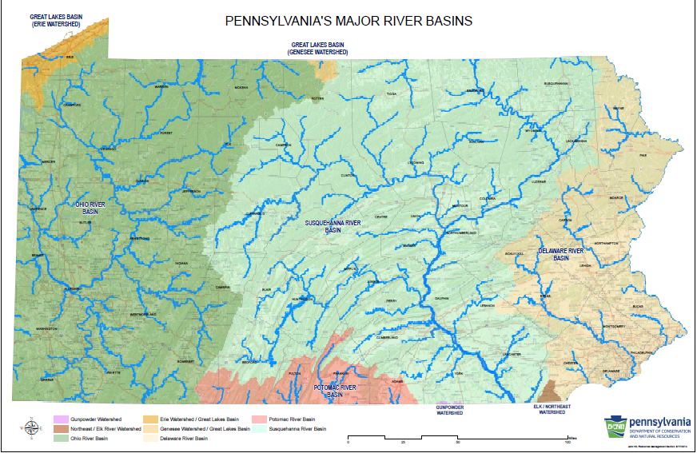

Slide 6
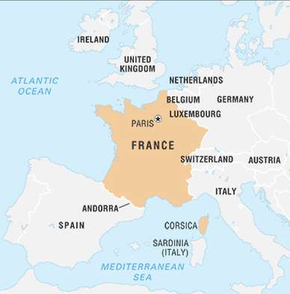
Ohio River Basin – The Big Picture
As a whole, the drainage area covers 203,940 square miles over the span of 15 states!
The Ohio River Basin consists of 3 large subbasins:
Ohio River
Allegheny River
Monongahela River
Allegheny River + Monongahela River = Ohio River

Slide 7
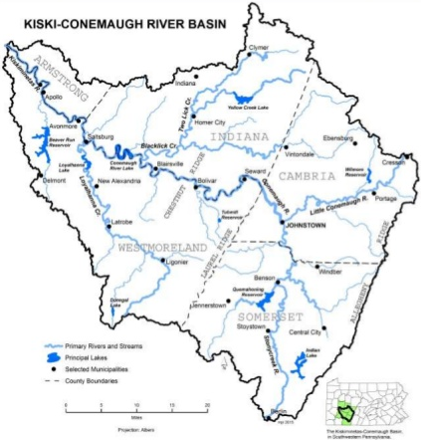
Kiski-Conemaugh River Basin – A Small Snapshot
Largest subbasin of the Allegheny River.
Makes up 16% of the Allegheny watershed!
Encompasses 5 counties:
Armstrong
Westmoreland
Indiana
Cambria
Somerset

Slide 8
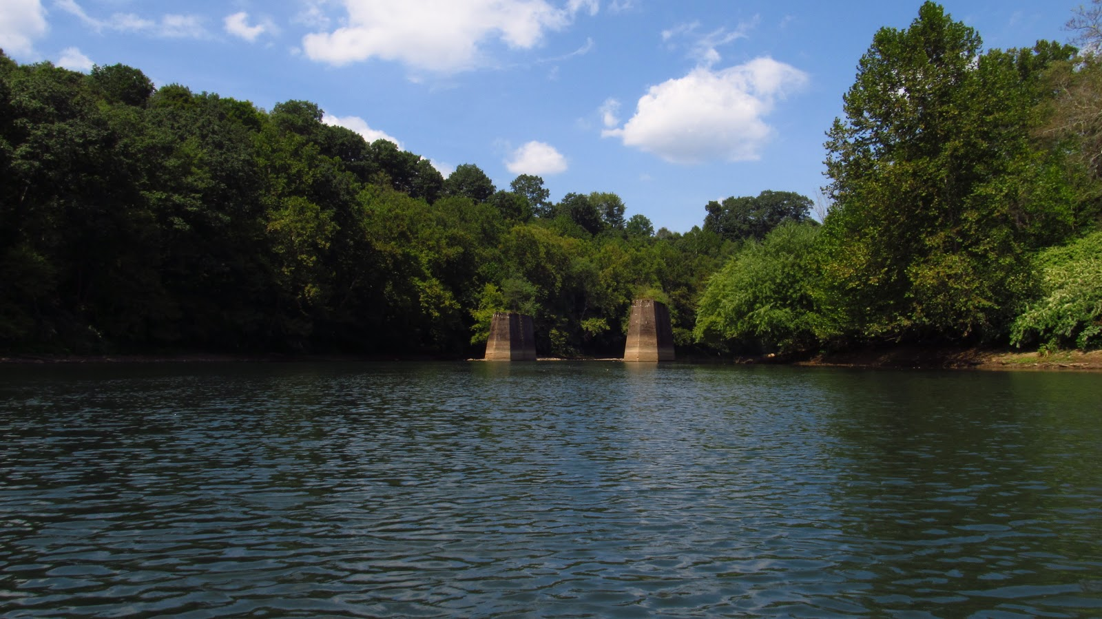
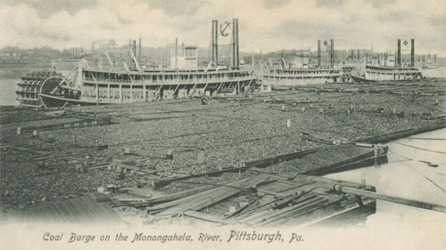
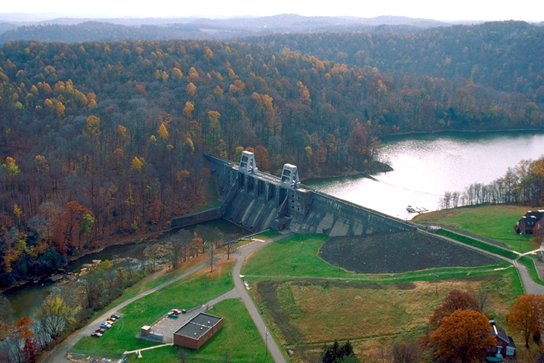
Humans in the Ohio River Basin
Water = life
All living things require air, space, shelter, food, and water.
Rivers have long sustained human life, providing drinking water, food, and transportation.

Slide 9
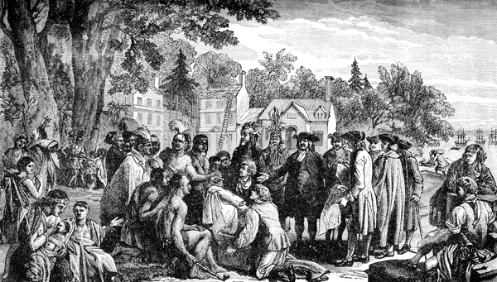
Humans in the Ohio River Basin
Native American Cultures to inhabit the Ohio River Valley:
Mound Builders
Iroquois
Shawnee
Delaware
Ohio = ‘Beautiful River’
Allegheny = ‘Fair Waters’
Monongahela = ‘High, Crumbling Banks’

Slide 10
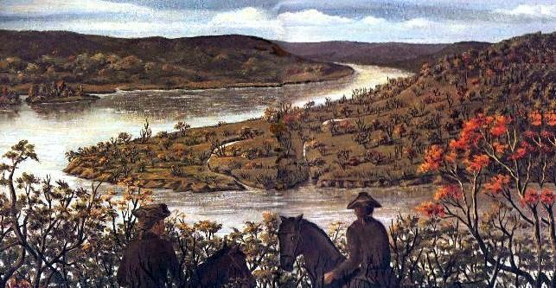
Humans in the Ohio River Basin
Fur traders were the first Europeans to navigate via these rivers.
French and Indian War (1754-1763)
The Ohio River Valley became a ‘Gateway to the West!’

Slide 11
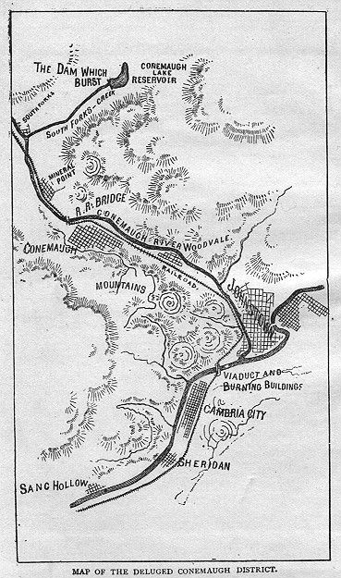
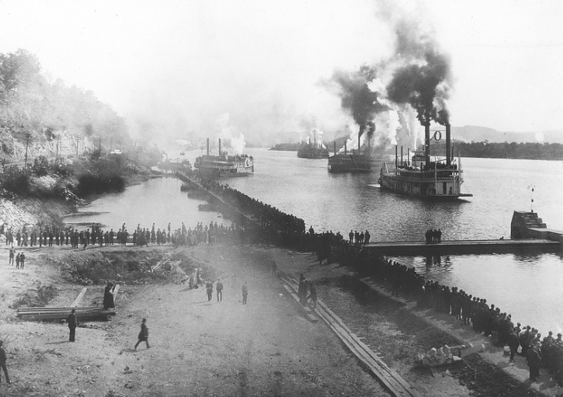
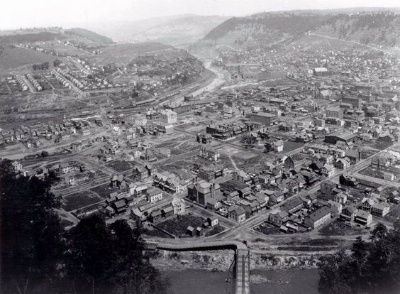
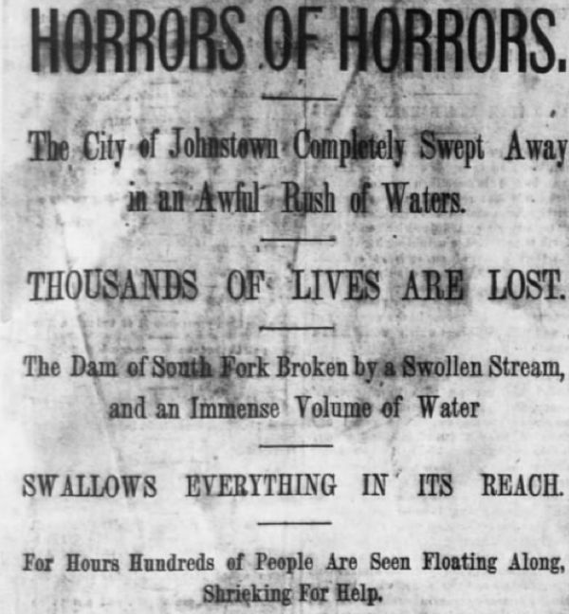
Humans in the Ohio River Basin
Inland Waterways Improvement Act passed in 1824.
US Army Corps of Engineers constructed first lock and dam.
Johnstown flood - 1889

Slide 12
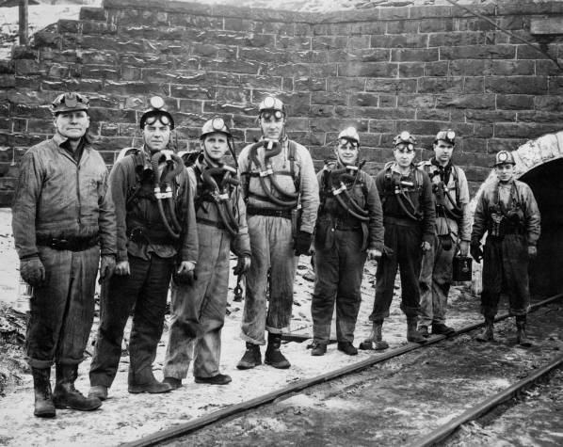
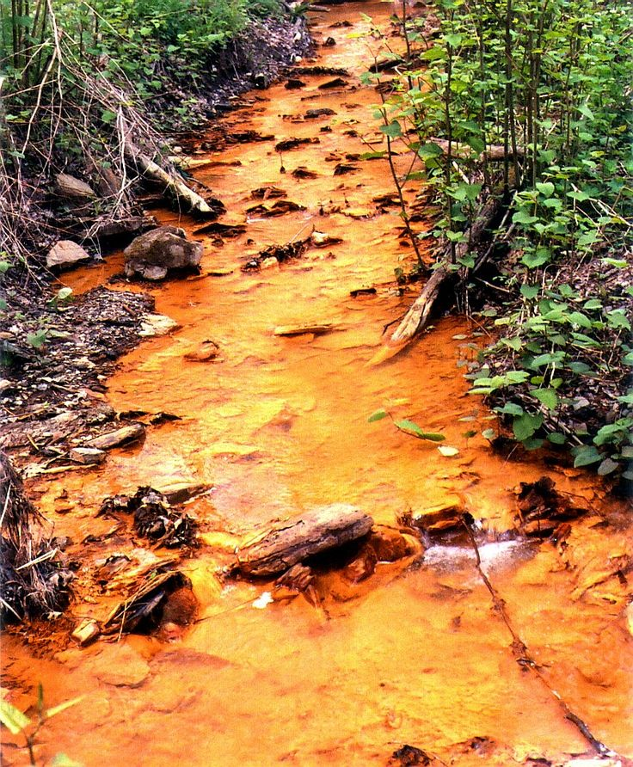
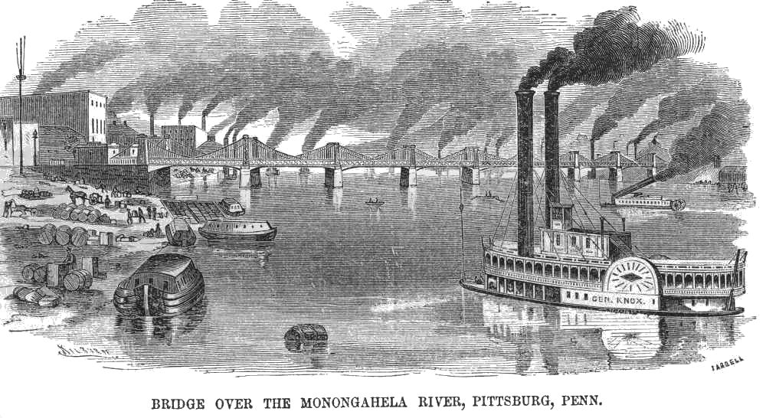
Humans in the Ohio River Basin
Industrial Revolution swept the US, increasing demands for coal, timber, iron, steel, gas/oil, and other raw materials.
River vs. Railroad
Extraction and refinement of natural resources greatly impacted our rivers.

Slide 13
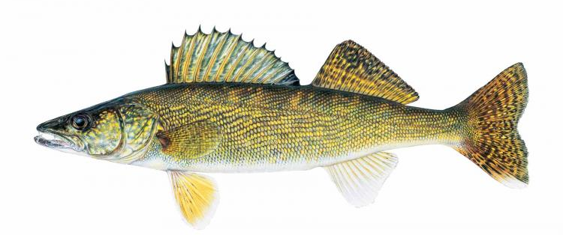
Humans in the Ohio River Basin
As a result of industrialization of western PA, the Kiski River and tributaries were highly polluted.
1980 – river was considered dead.
Survey repeated in 2015, with positive results!
386 individuals of 28 species were discovered.
Species diversity increased, sensitive species increased.

Slide 14
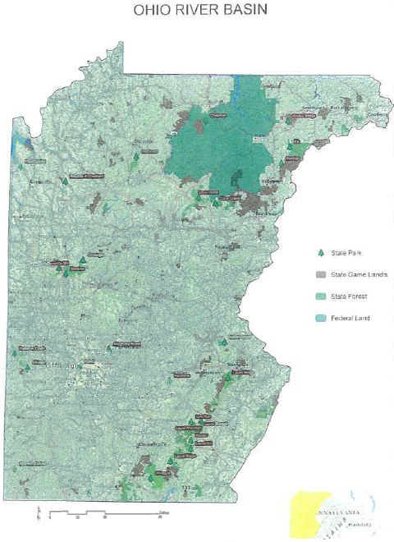
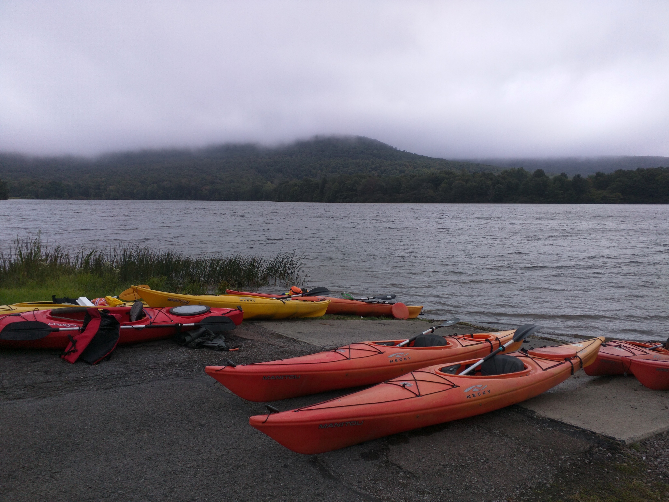
Life in the Ohio River Basin
River conservation efforts continue today with local watershed groups, non-profits, state/federal agencies, and YOU!
State parks and forests help conserve our natural landscapes while providing places to recreate.
27 state parks
6 state forests

Slide 15
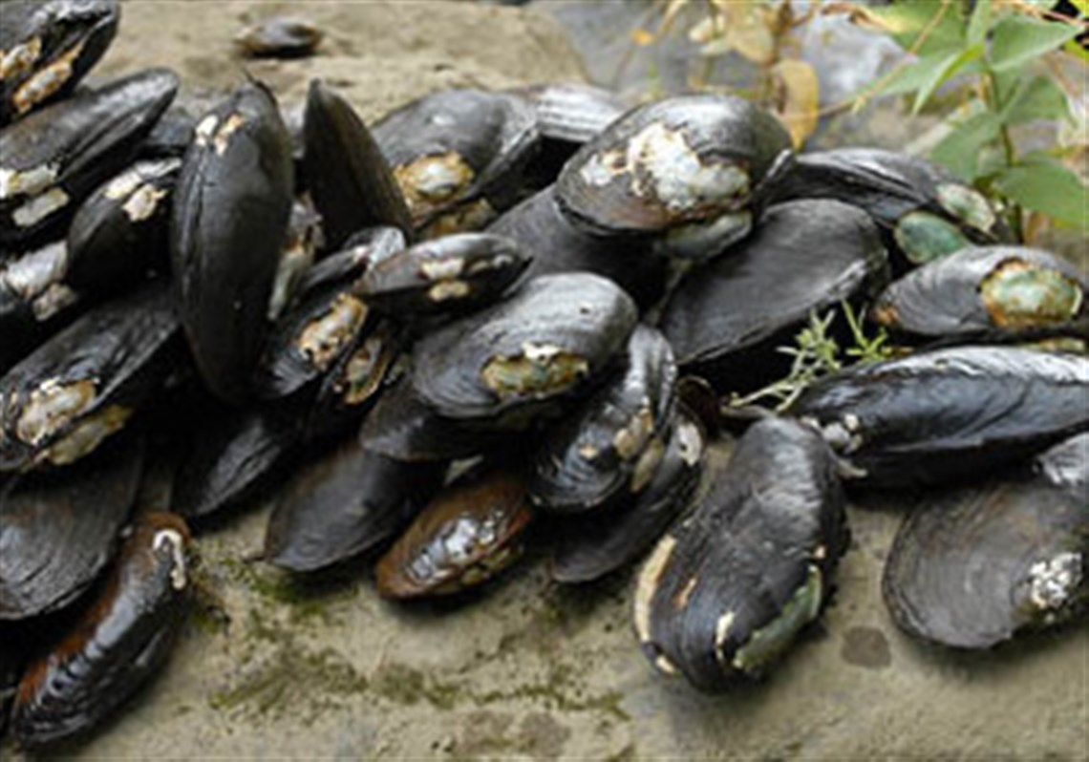
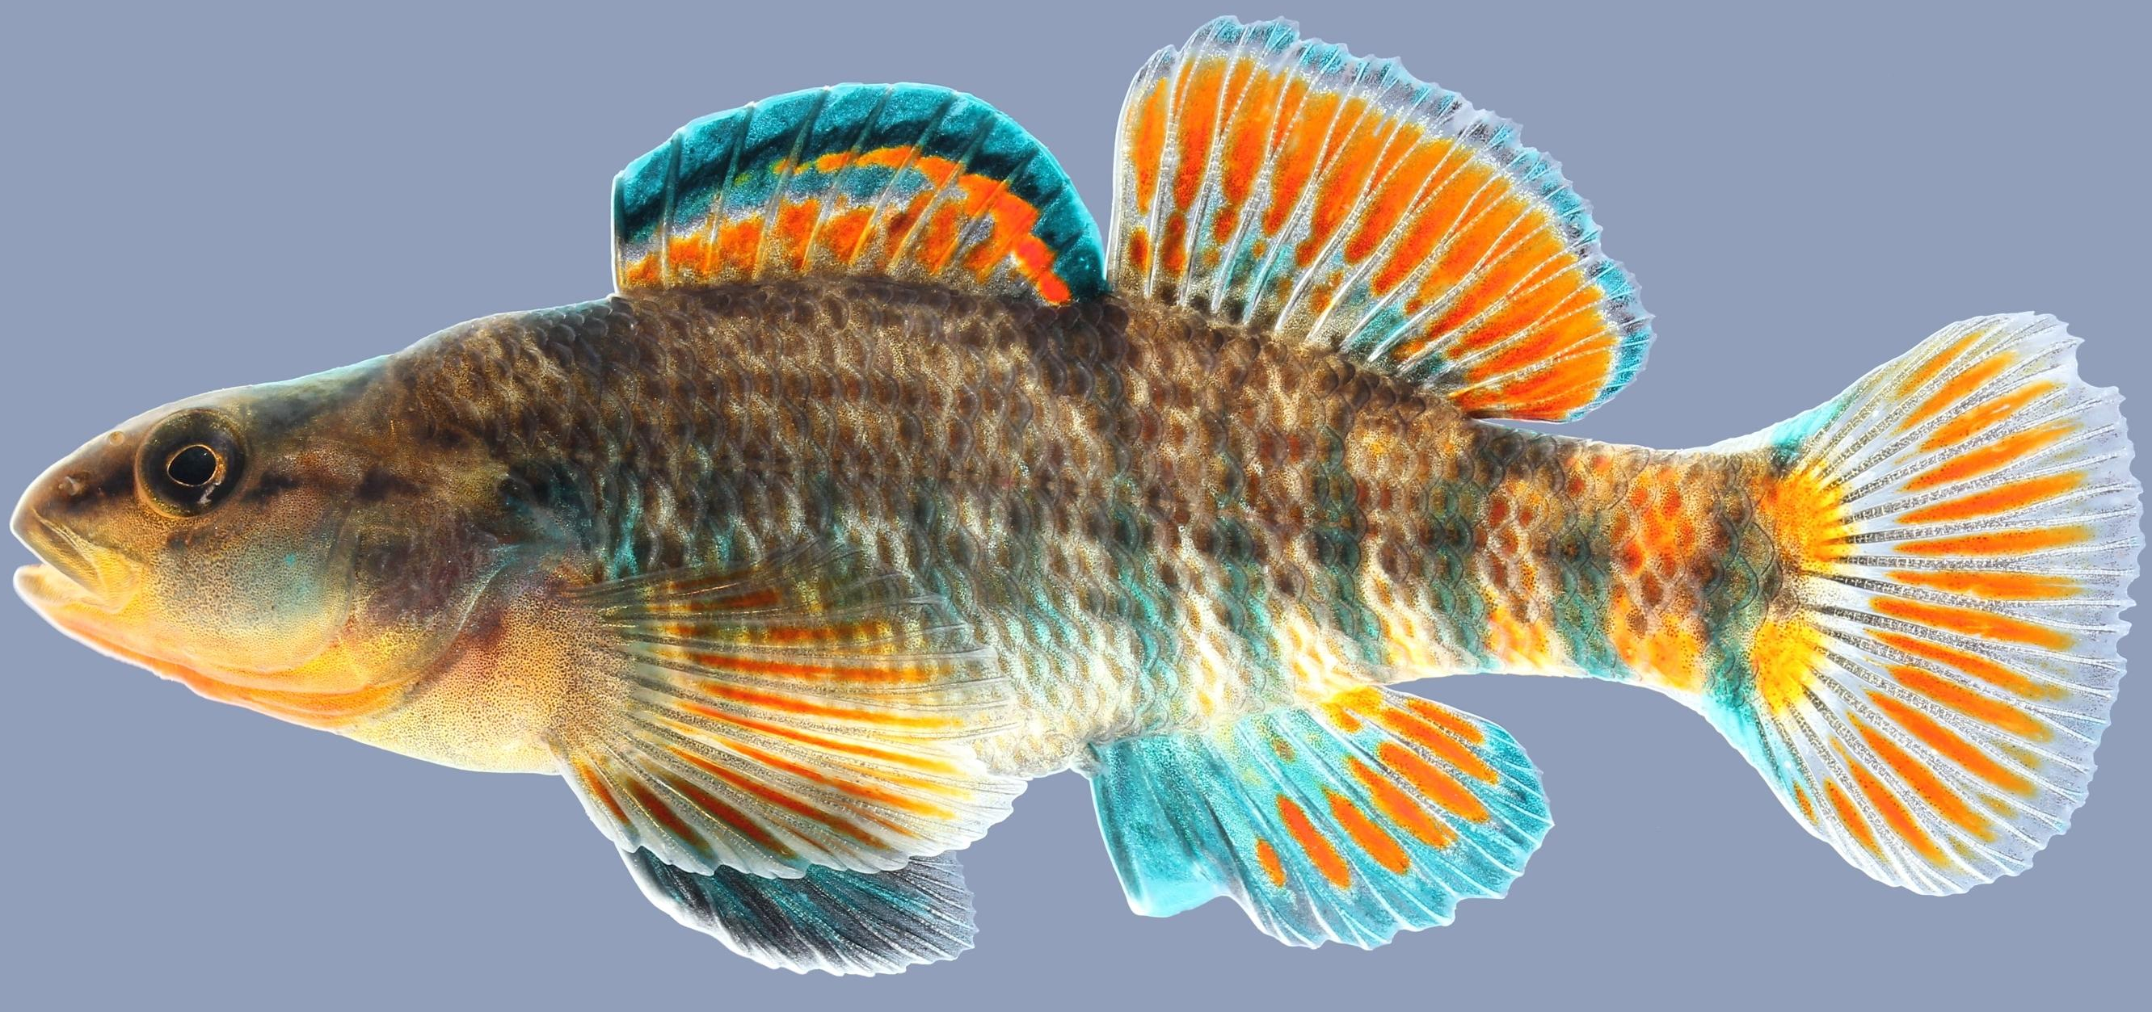
Life in the Ohio River Basin
Water = life
Rivers and streams have long supported diversity of wildlife, including plants and animals.
The Ohio River is the only basin in PA that drains into the Gulf of Mexico.
Greatest diversity of freshwater mussel species in state.
18 different species of darters.

Slide 16
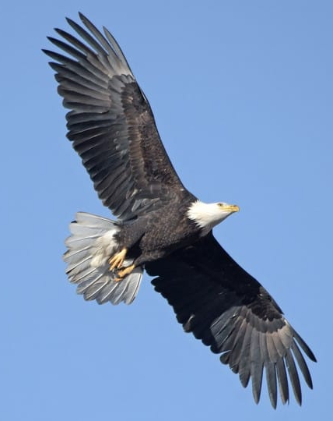
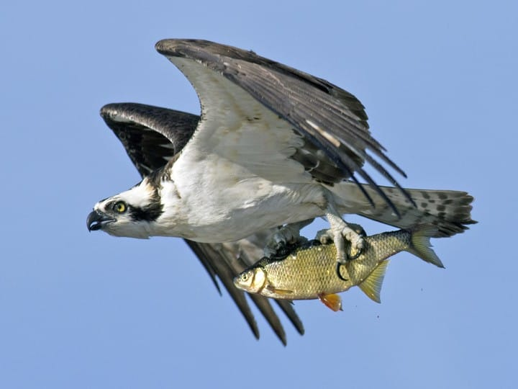
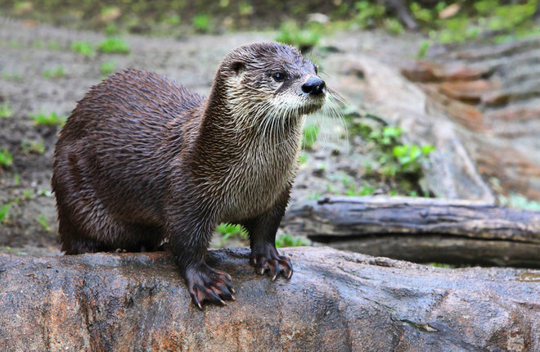
Life in the Ohio River Basin
Wildlife conservation success stories:
River Otter
Bald Eagle
Osprey

Slide 17
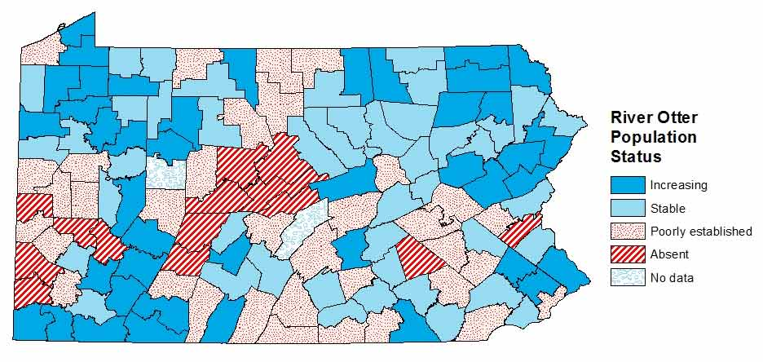
Life in the Ohio River Basin: River Otter

Slide 18
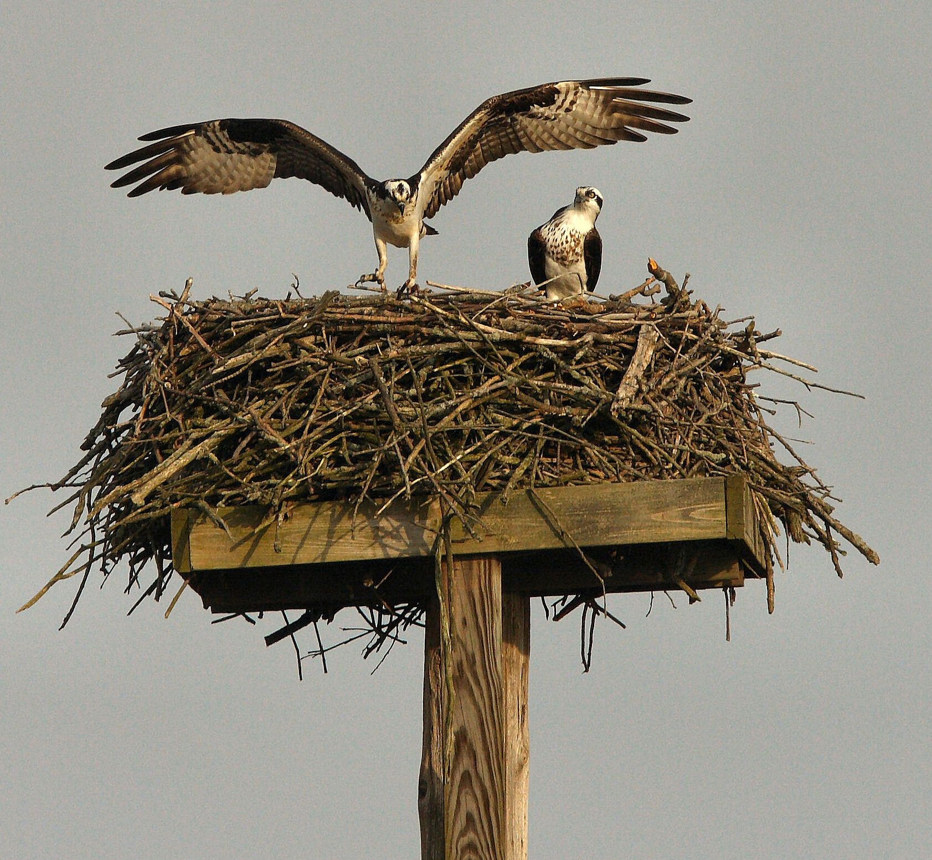
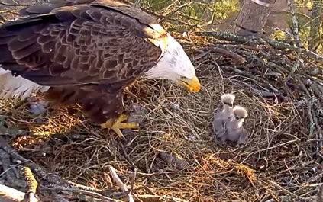
Life in the Ohio River Basin: Bald Eagles and Osprey
Reproductive failure is common to both osprey and bald eagles.
1983 only 3 nesting pairs of bald eagles in PA.
As of 2013 there are 250 bald eagle nests in PA!
1985 first documented pair of osprey since 1910.
115 osprey nests in 21 counties reported in 2010!

Slide 19
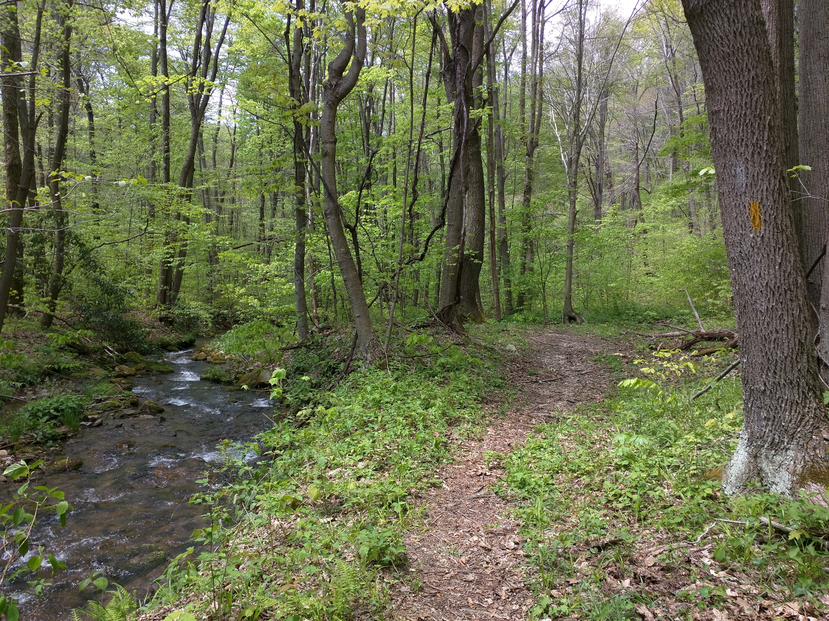
Rivers flow not past but through us.
John Muir

Slide 20
References
Executive Summary: State of the Kiski-Conemaugh River Watershed – An Update to the 1999 Kiski-Conemaugh River Basin Conservation Plan
Kiski-Conemaugh River Conservation Plan
Watershed Education Teacher Manual
Images:
https://www.google.com/search?rls=com.microsoft%3Aen-US%3AIE-SearchBox&biw=1680&bih=881&tbm=isch&sa=1&ei=z0YRW7uuEsOkjwS3oozACA&q=kiski-conemaugh+river+map&oq=kiski-conemaugh+river+map&gs_l=img.3...200.2332.0.2618.16.8.0.0.0.0.0.0..0.0....0...1c.1.64.img..16.0.0....0.HL0Xgc7HtTM#imgrc=B6rIDxbhm91DmM:&spf=1527858910326
http://social.rollins.edu/wpsites/hist120/2012/12/05/native-americans-in-early-america-and-pennsylvania/
http://coalandcoke.blogspot.com/2015/08/canal-ruins-along-kiskiminetas.html
http://popularpittsburgh.com/darkhistory/
http://www.lrp.usace.army.mil/Missions/Recreation/Lakes/Loyalhanna-Lake/
http://www.brooklineconnection.com/history/Facts/Washington.html
https://www.flickr.com/photos/louisvilleusace/9682915778
http://www.neatorama.com/2018/01/10/Black-Friday-1889-the-Johnstown-Flood/
https://www.iup.edu/archives/coal/coal-culture-background/
https://nature.mdc.mo.gov/discover-nature/field-guide/walleye
https://www.phipps.conservatory.org/blog/detail/biopgh-blog-ecology-lessons-from-pennsylvania-darters

